Slide 1
INFO6003 Lab-06
Gihan Shamike Liyanage
1142109

Slide 2
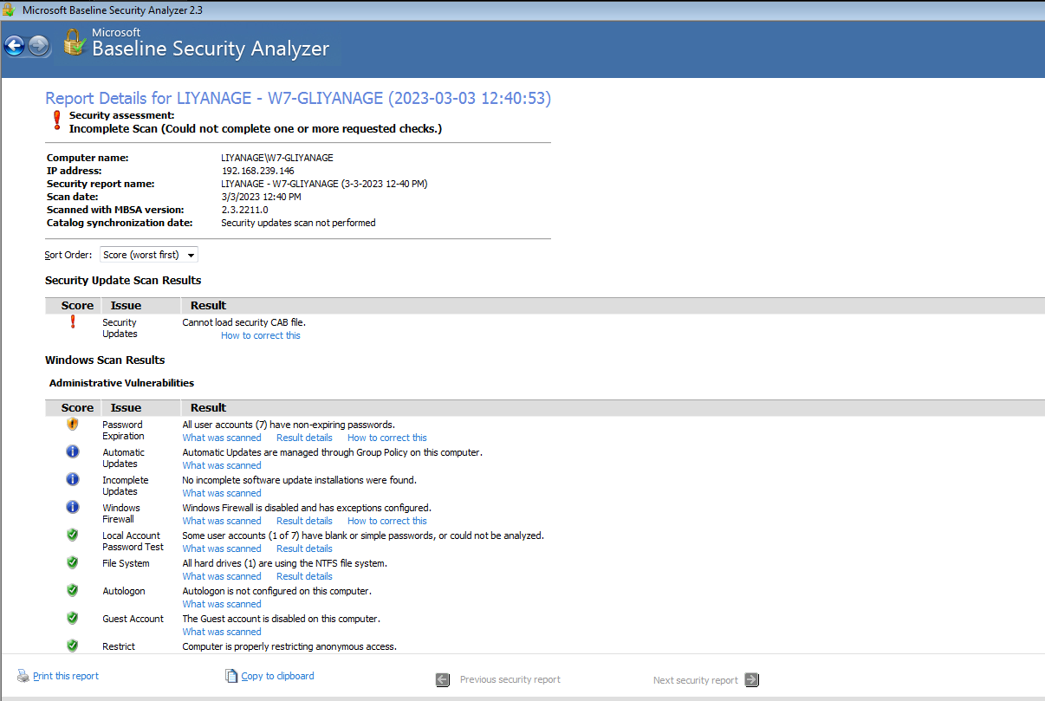
Slide #1

Slide 3
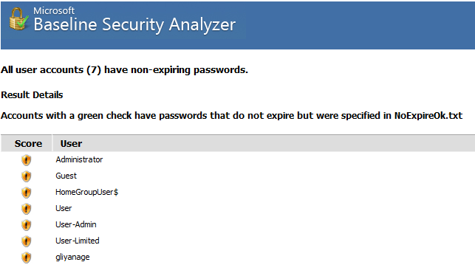
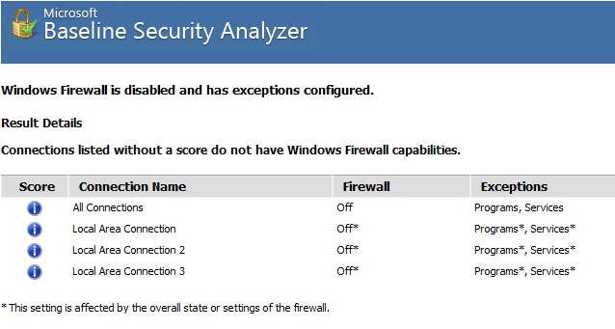
What accounts failed the password expiration check?
Did any accounts pass the password expiration check? No
What is the status of the windows firewall? Disabled and has exceptions configured.

Slide 4
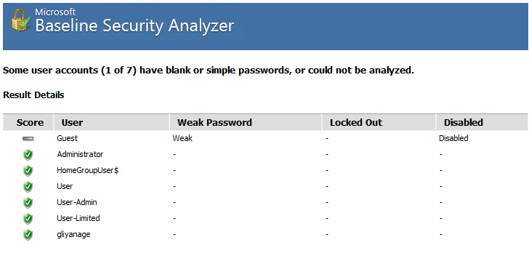
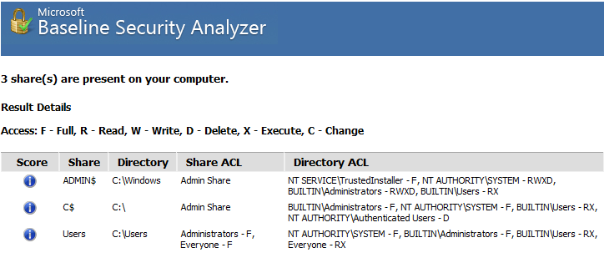
What is the result of the Local Account Password Test?
Is autologon set for this system? No. Autologon is not configured on this computer.
Is the guest account enabled? The Guest account is disabled on this computer.
Are there multiple administrators on this system? No more than 2 Administrators were found on this computer.
Are there any potentially unnecessary services running on this system? No potentially unnecessary services were found.
What shares are available on the system? 3 Shares

Slide 5
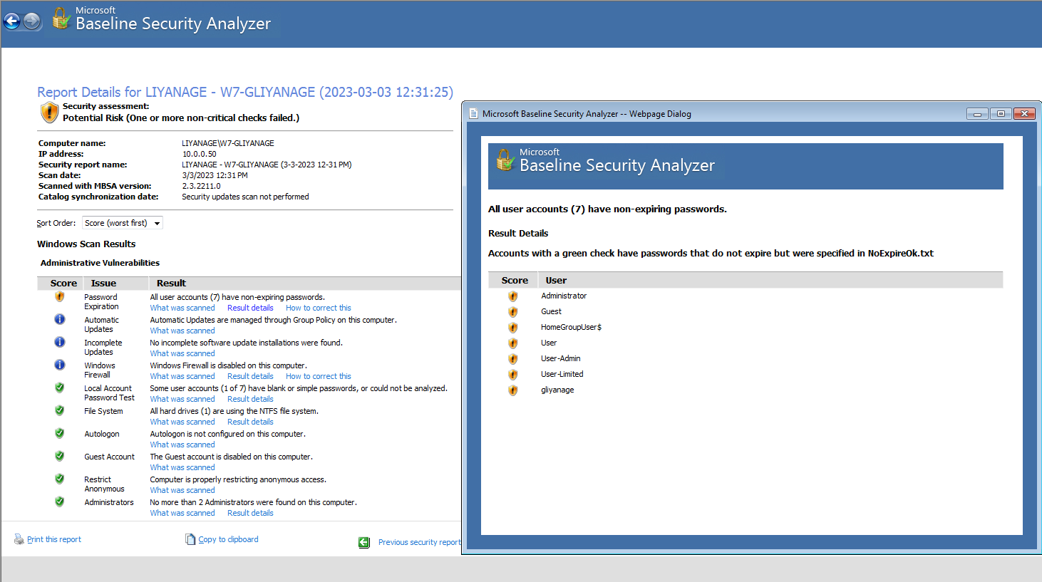
Slide #2

Slide 6
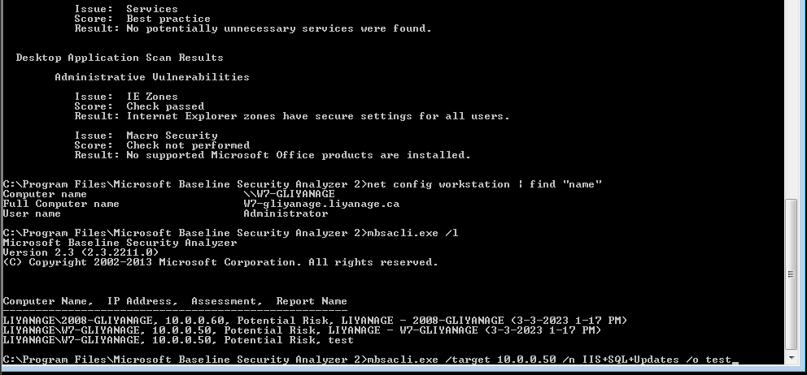
Slide #3

Slide 7
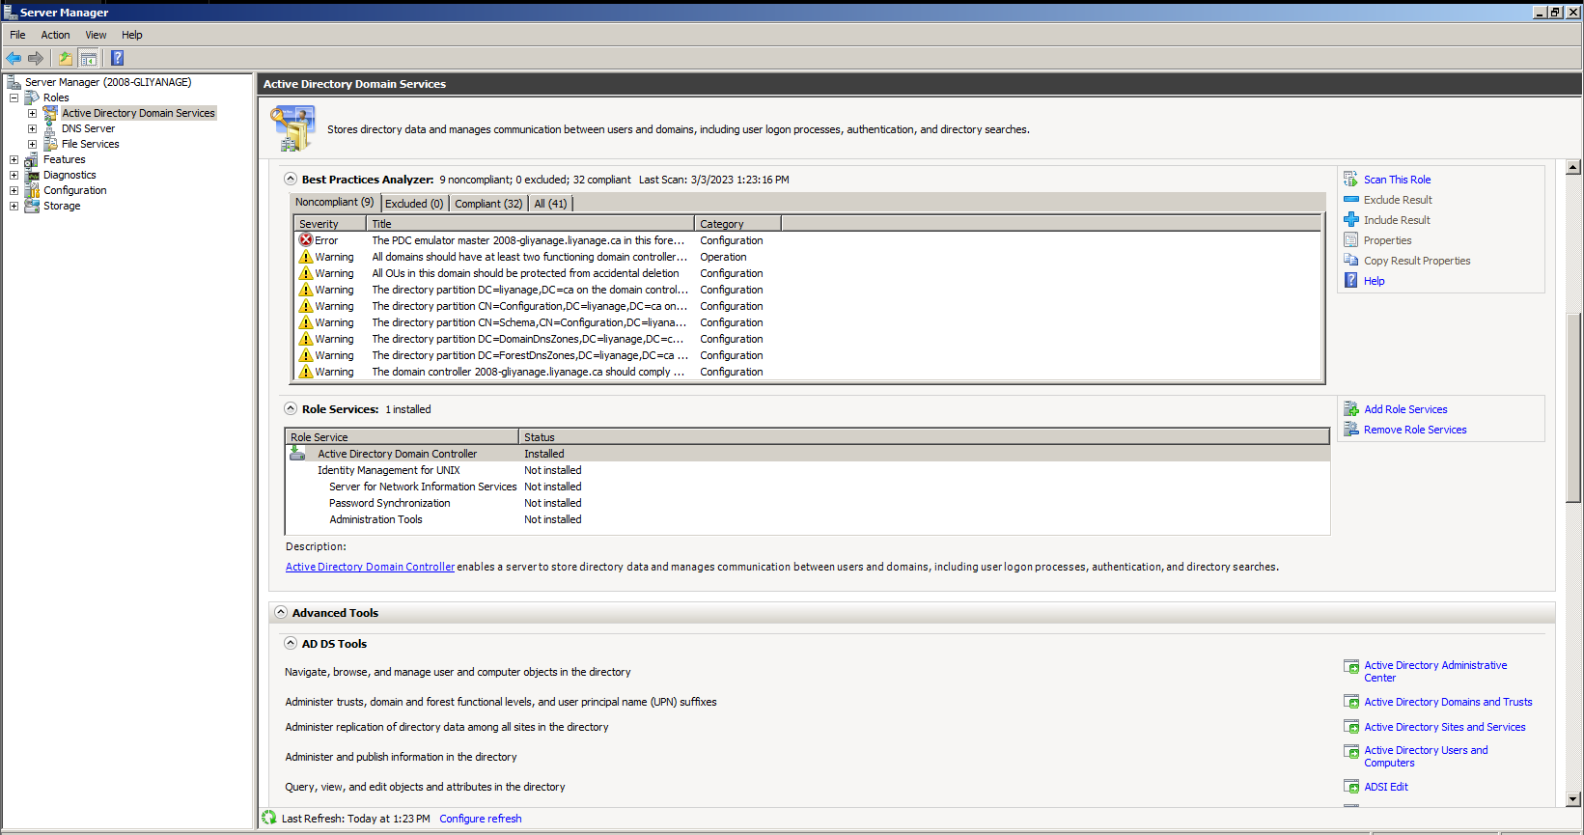
Slide #4

Slide 8
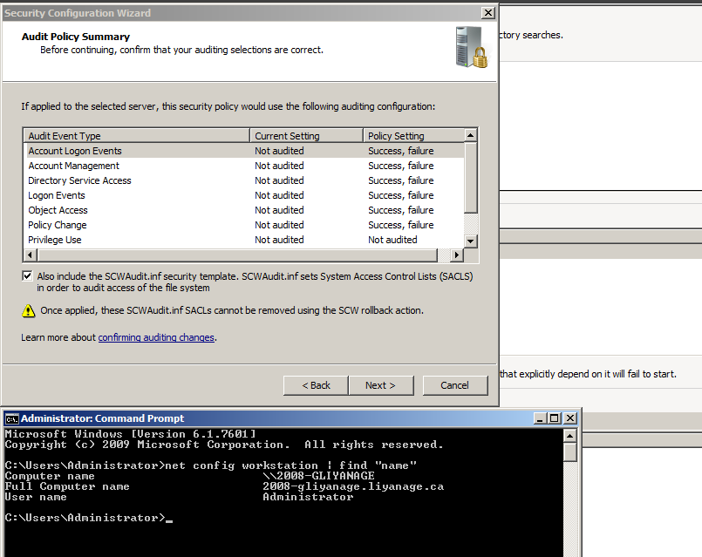
Slide #5

Slide 9
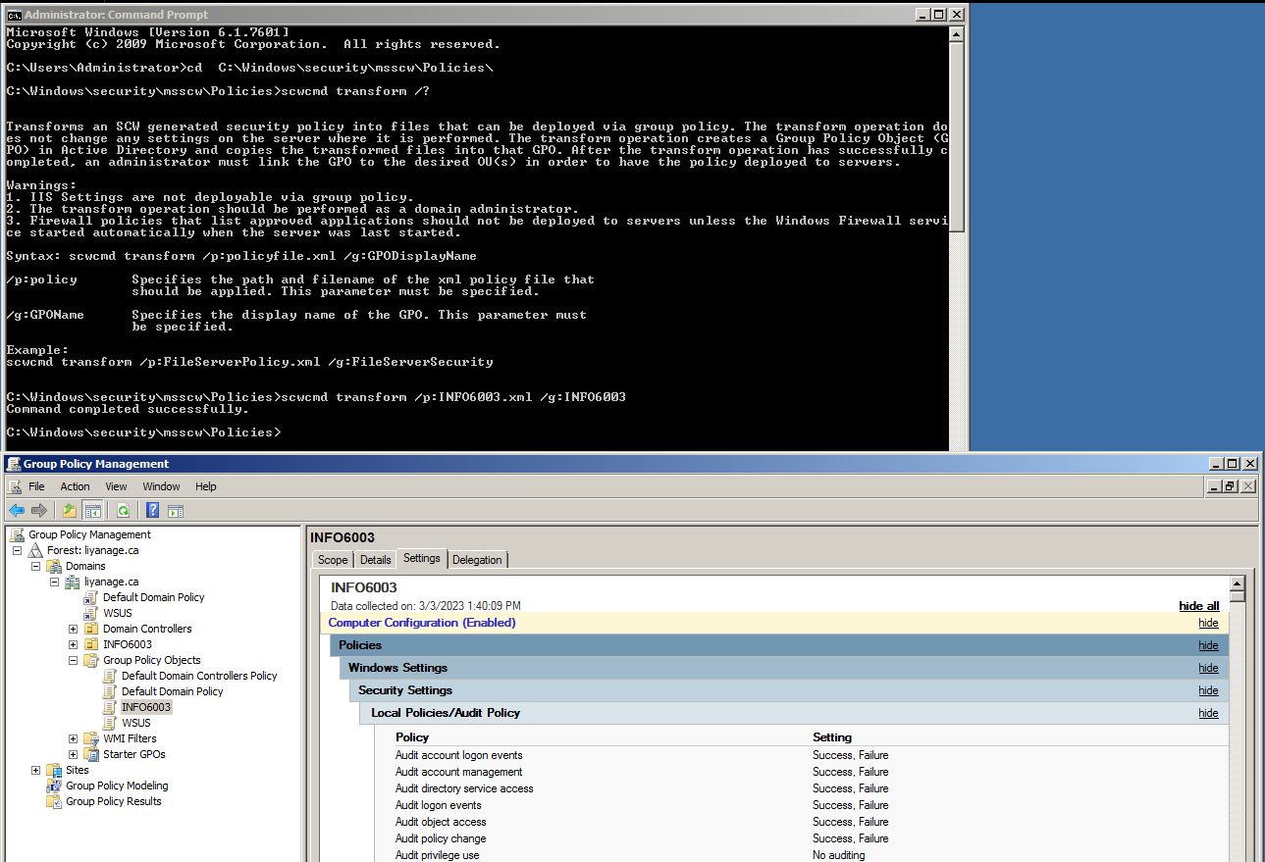
Slide #6

Slide 10
Slide #7

Slide 11
Slide #8

Slide 12
Slide #9

Slide 13
Slide #10

